Slide 1

How Coffee Affects the Brain
Exploring caffeine's impact on brain function
Notes:
AI-generated content may be incorrect. --- This presentation explores the fascinating relationship between coffee consumption and brain function. We will examine how caffeine influences our neurological processes, the benefits of drinking coffee, and potential drawbacks to consider.

Slide 2

Presentation Overview
Science of Caffeine
We will explore how caffeine affects neurotransmitters in the brain and its overall impact on brain function.
Benefits of Coffee
The presentation will highlight the cognitive enhancement and health benefits associated with regular coffee consumption.
Drawbacks of Coffee
We will also discuss potential drawbacks of coffee, such as anxiety and withdrawal symptoms that some individuals may experience.
Notes:
We will begin by discussing the science behind caffeine and how it interacts with neurotransmitters in the brain. Next, we’ll delve into the various benefits of coffee consumption, including cognitive enhancement and long-term health effects. Finally, we will address some potential drawbacks, including anxiety and withdrawal symptoms.

Slide 3

The Science of Caffeine
Caffeine as a Stimulant
Caffeine acts as a central nervous system stimulant, enhancing alertness and reducing fatigue.
Impact on Adenosine
Caffeine blocks adenosine receptors, which increases neurotransmitter activity and promotes wakefulness.
Effects on Daily Life
Understanding caffeine's effects helps us recognize its role in daily activities and productivity.
Notes:
Understanding how caffeine affects the brain is essential to grasping its impact on our daily lives. Caffeine is a central nervous system stimulant that blocks adenosine receptors, affecting neurotransmitter activity.

Slide 4
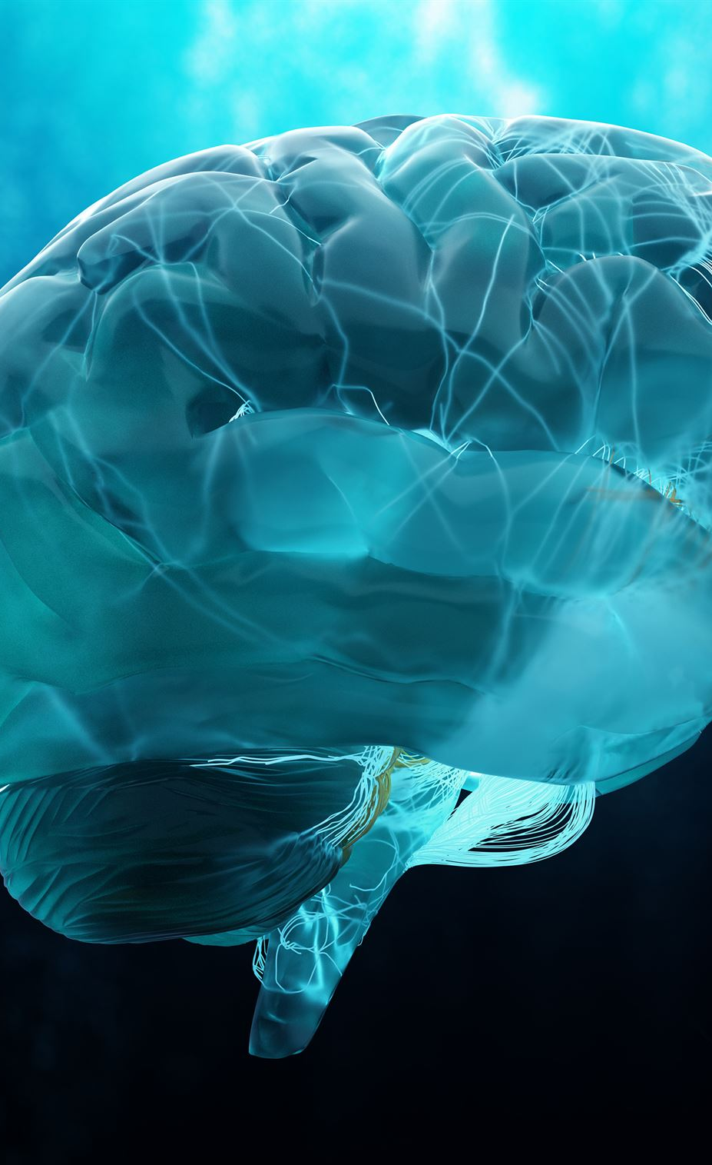
Caffeine and Neurotransmitters
Adenosine Blocking
Caffeine blocks adenosine's action, preventing sleepiness and promoting wakefulness.
Release of Dopamine
The blocking of adenosine leads to increased dopamine release, enhancing mood and pleasure.
Enhanced Alertness
Caffeine increases norepinephrine release, further boosting alertness and energy levels.
Notes:
Caffeine primarily works by blocking the action of adenosine, a neurotransmitter that promotes sleep and relaxation. This leads to increased release of neurotransmitters like dopamine and norepinephrine, enhancing alertness and energy levels.

Slide 5

Impact on Mood and Alertness
Improved Mood
Coffee consumption can lead to enhanced mood, often resulting in a more positive outlook and increased motivation.
Enhanced Alertness
Caffeine in coffee helps to increase alertness, making it easier to stay awake and focused on tasks.
Increased Productivity
Many individuals find that coffee boosts their productivity levels, helping them to complete tasks more efficiently.
Notes:
The consumption of coffee can lead to improved mood and enhanced alertness. Many people report increased focus and reduced fatigue, making coffee a popular choice for productivity.

Slide 6

Benefits of Coffee Consumption
Cognitive Enhancement
Coffee consumption has been linked to improved cognitive function, including enhanced memory and focus.
Mood Improvement
Regular coffee drinkers often report better mood and reduced risk of depression, contributing to overall mental well-being.
Informed Choices
Understanding the cognitive benefits of coffee can empower individuals to make healthier lifestyle choices regarding their consumption.
Notes:
Beyond its stimulating effects, coffee has been associated with several cognitive benefits. Understanding these can help individuals make informed choices about their coffee consumption.

Slide 7
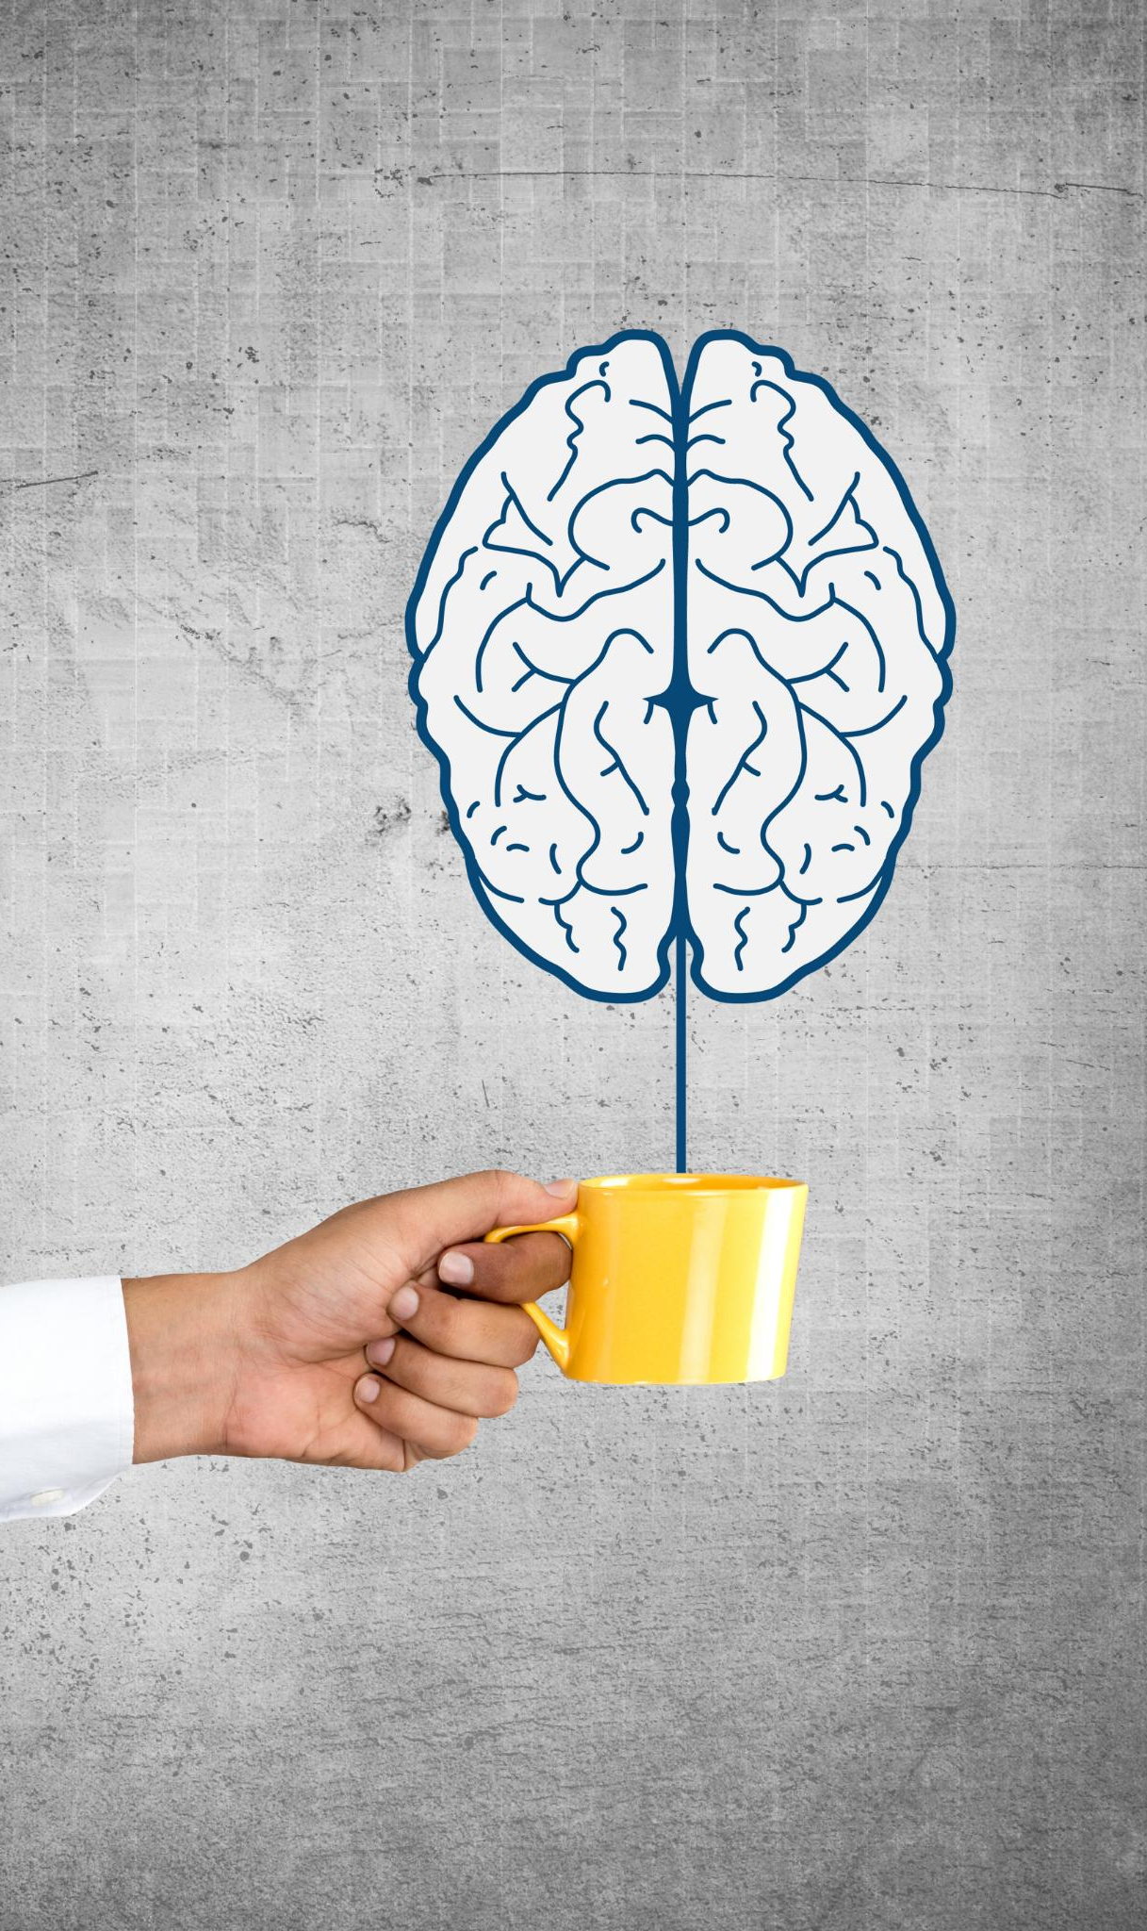
Cognitive Enhancement
Caffeine and Attention
Caffeine is shown to enhance attention, making tasks easier to focus on and execute effectively.
Reaction Time Improvement
Studies suggest that caffeine can improve reaction time, which is critical in various activities and tasks.
Mental Performance
Regular coffee consumption is associated with enhanced overall mental performance and cognitive abilities.
Notes:
Research indicates that caffeine can improve cognitive performance, particularly in areas like attention and reaction time. Regular coffee consumption is often linked with better mental performance.

Slide 8

Long-term Health Benefits
Neurodegenerative Disease Risk
Moderate coffee consumption may lower the risk of diseases like Alzheimer's and Parkinson's, based on recent studies.
Antioxidants in Coffee
Coffee is rich in antioxidants, which are believed to contribute to its potential health benefits and protective effects.
Notes:
Studies suggest that moderate coffee consumption may be associated with a lower risk of neurodegenerative diseases such as Alzheimer's and Parkinson's. Antioxidants found in coffee may contribute to these protective effects.

Slide 9

Potential Drawbacks and Considerations
Caffeine Sensitivity
Individuals sensitive to caffeine may experience symptoms like anxiety, insomnia, or increased heart rate when consuming coffee.
Impact on Sleep
Consuming coffee, especially in the afternoon or evening, can disrupt sleep patterns and reduce overall sleep quality.
Mindful Consumption
Being aware of the quantity and timing of coffee consumption can help mitigate negative effects while still enjoying its benefits.
Notes:
While coffee has many benefits, it is also important to consider its potential negative effects, especially for those sensitive to caffeine. Understanding these aspects can help guide more mindful consumption.

Slide 10
Anxiety and Insomnia
Effects of Caffeine
High caffeine intake can lead to increased anxiety levels and disrupt normal sleep patterns, affecting overall well-being.
Anxiety Triggers
Individuals prone to anxiety may experience exacerbated symptoms from drinking coffee, highlighting the need for careful consumption.
Monitoring Consumption
It is essential for individuals with anxiety to monitor their caffeine consumption to help manage symptoms effectively.
Notes:
High caffeine intake can lead to heightened anxiety and disrupt sleep patterns. Individuals prone to anxiety may find that coffee exacerbates their symptoms, making it essential to monitor consumption.

Slide 11

Withdrawal Symptoms
Caffeine Withdrawal Overview
Caffeine withdrawal can cause various symptoms including headaches, fatigue, and irritability after reducing intake.
Headaches
One of the most common symptoms of caffeine withdrawal is headaches, which can vary in intensity.
Fatigue
Fatigue is another significant symptom, leading to a general sense of tiredness and lack of energy.
Irritability
Irritability can also occur during caffeine withdrawal, affecting mood and social interactions.
Notes:
Regular caffeine consumers may experience withdrawal symptoms such as headaches, fatigue, and irritability when they significantly reduce or stop their intake. Awareness of this can help manage caffeine consumption effectively.

Slide 12
Conclusion
Positive Effects of Coffee
Coffee can enhance alertness, improve concentration, and boost cognitive function when consumed in moderation.
Negative Effects of Coffee
Excessive coffee consumption may lead to anxiety, insomnia, and other negative impacts on mental health.
Importance of Moderation
Understanding the balance of coffee consumption can help maximize its benefits while minimizing its risks.
Notes:
Coffee can have both positive and negative effects on the brain. By understanding how it affects our neurological processes, we can appreciate its benefits while also being mindful of potential drawbacks. Moderation is key.

